Slide 1


SAP UI5 & FIORI with OData TRAINING
Anubhav Oberoy & Shekhar Vedi
Day – 22

Slide 2

Agenda – Day 22
S/4HANA Fiori Implementation – The statement
Some Standard SAP Roles in S/4HANA
Fiori Rapid Activation and Deployment
Rapid Deployment – Best Practice
Concept of Task List
Fiori Rapid Activation – Further Read
SAP Process and Standard Content
How SAP Designer their launchpad content
SAP Fiori Launchpad content
How to activate all apps in one-go for a Business Role

Slide 3


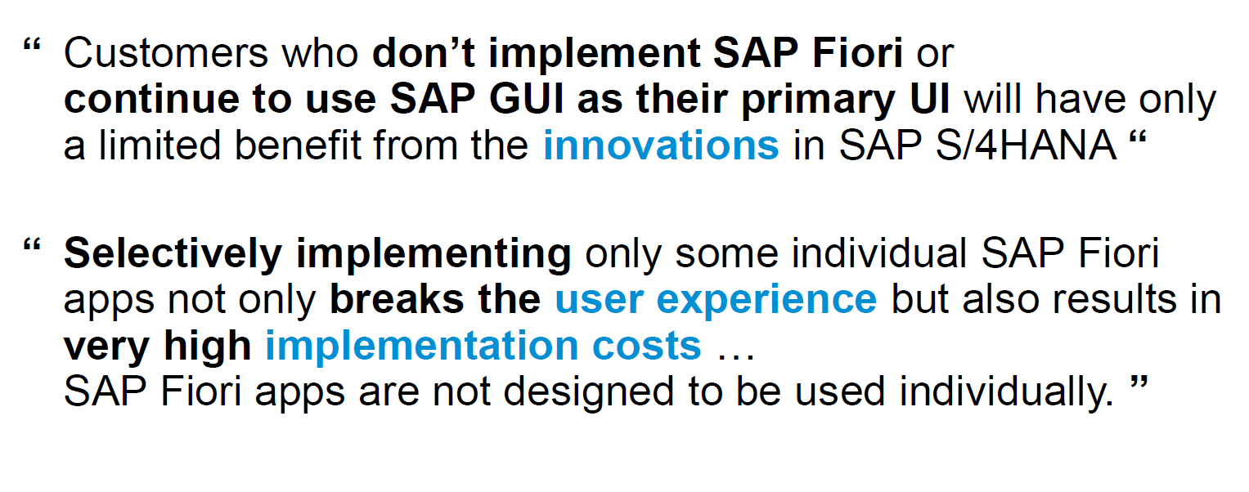
S/4HANA Fiori Implementation – The statement
www.anubhavtrainings.com

Slide 4
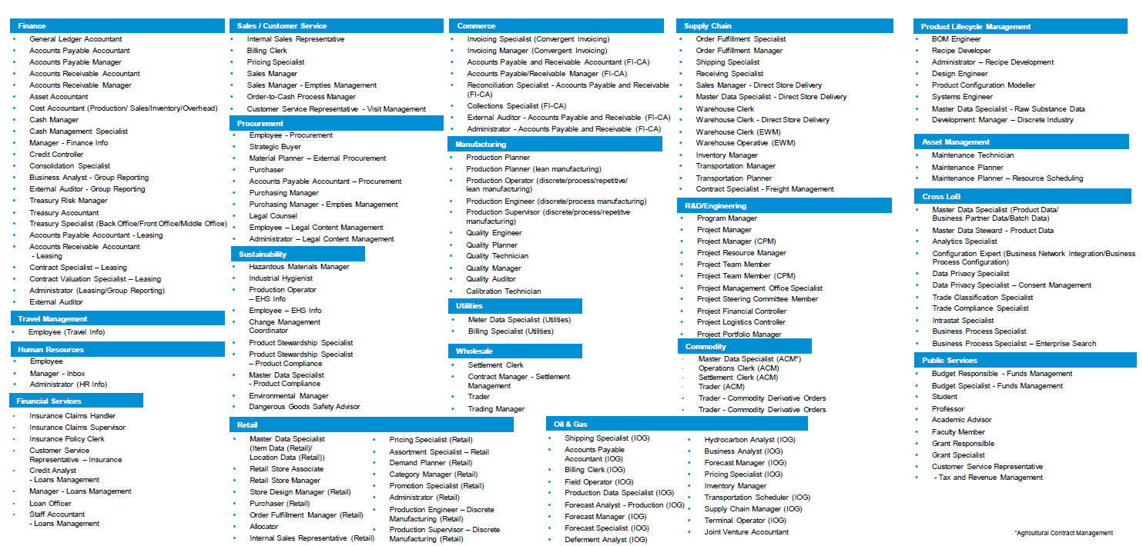
Some Standard SAP Roles in S/4HANA
www.anubhavtrainings.com

Slide 5
Technical Standpoint
Functional Aspect
Make Fiori Run in system
Fiori Infrastructure
Which apps based on Role

Slide 6
Fiori Rapid Activation and Deployment
In the past, when fiori was introduced in ECC, We used to perform lots of manual activities step-by-step like activate gateway, activate standard fiori services, create sicf nodes, create roles for test, copy sap roles…
We used to inject lots of authorization manually and activate OData services for each app, Also activation was done app by app, which is very time consuming.
Any manual process is time taking and error prone.
SAP teams gave this feedback (RIG – Regional Implementation Group) to development and
With SAP S/4HANA 2209 onwards SAP introduce concept of Rapid Fiori Deployment, and activate.
All of these activities are simplified to ONE CLICK.
Automation – SAP built so many ABAP reports which are arranged in a sequence to activate fiori
Speed
Don’t have to even bother about future changes or read fiori security in detail
www.anubhavtrainings.com

Slide 7
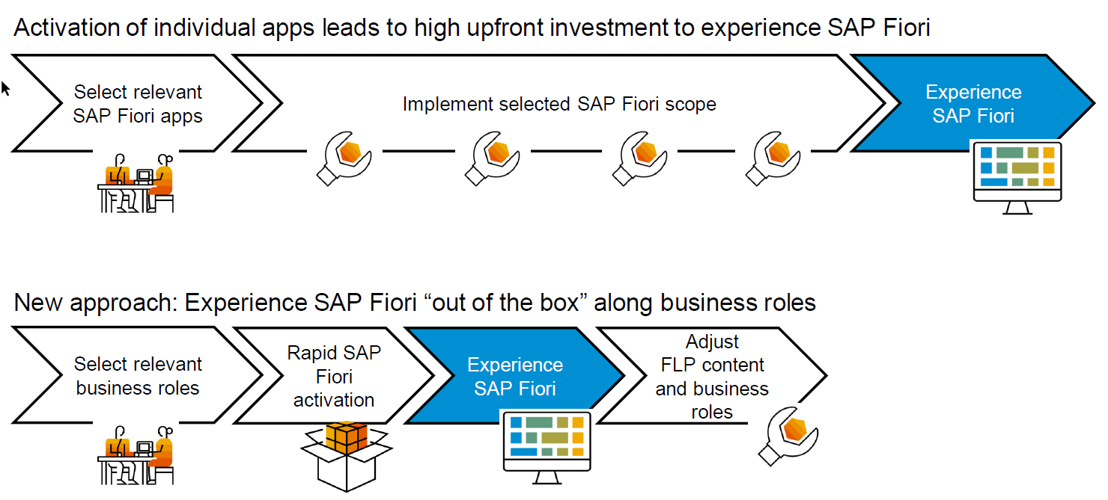
Rapid Deployment – Best Practice
www.anubhavtrainings.com

Slide 8
Concept of Task List
SAP NW 7.4 onwards there is a new concept of Task list – Tcode – STC01
Instead of doing multiple manual activities, we can do a one click execution of task list and the task list is designed to work in sequence and execute all the work in automatic way.
The task list approach only applies to S.4HANA
It work for both Embedded and Central HUB, we need to follow SAP guidance on task list if we using different system
Starring S/4HANA 2021
SAP_GW_FIORI_ERP_ONE_CLNT_SETUP – Responsible for Activating SAP Gateway and Entire Fiori Launchpad (and designer)
SAP_ESH_INITIAL_SETUP_WRK_CLIENT – Activating Enterprise search
SAP_FIORI_FOUNDATION_S4 – Responsible for deploy Fiori like set theme, create launchpad and admin role
www.anubhavtrainings.com

Slide 9
Fiori Rapid Activation – Further Read
For everyone:
SAP Fiori for SAP S/4HANA wiki
For IT Leaders:
Mapping Your Journey to SAP S/4HANAA Practical Guide for Senior IT Leadership
For project managers:
Top 10 Myths and Misconceptions
Essential Roles for SAP S/4HANA Projects
For the whole project team:
Speed up your Fiori support
–Guided answer: How to create the perfect Fiori Incident
For functional consultants:
Top 5 Fiori features that bring value to every business user
Best UX resources for Functional Consultants
Finding the delta of new apps between SAP S/4HANA versions
Finding the technical name of an app
For the technical team:
Fiori rapid content activation–4 part series
How to extend Fiori apps
–Guided answer: How to extend a SAP Fiori app in SAP S/4HANA
–Understanding extensibility: UI flexibility
Performance tips and tricks -S/4HANA on premise
Readiness Check 2.0 –Details about the topic of Fiori
Internet facing considerations and recommendations
www.anubhavtrainings.com

Slide 10
SAP Process and Standard Content
The entire S/4HANA implementation is based on Best practice guide.
Order-to-cash – Company to company deal
I am working in IBM and my co. offers me a car to purchase. I can go to honda, hyndai, Maruti…
SAP provide 229+ processes which are best practice for different areas.
https://rapid.sap.com
Quotation
Approval Quote
Billing
Sales Order
Approval of Sales order
Delivery
Payment
www.anubhavtrainings.com

Slide 11
Technical Catalog (TC) – All the applications (tiles, mapping) pertaining to one area is group by SAP in a technical catalog HR, SALES, SERVICE.
Business Catalog (BC) – It is a catalog pertaining to one business Role which can be added to sap business role to give controlled access of particular apps pertaining to business personnel. SAP reference the apps from technical catalog to business catalog

Slide 12
How SAP Designer their launchpad content
Sales
Sales Managers
Sales Managers
SAP_BR_SALES_MANAGER
ALL THE TILES REALTED TO SALES AREA , COMPLETE DEPARTMENT AND THEIR TARGET MAPPING WILL BE KEPT IN A SEPRATE CATALOG
TECHNICAL CATALOG
SAP_BC
SAP_BCG
Marketing
Sales Accountant
Sales Accountant
Sales Accountant
Sales Accountant
SAP_BR_SALES_ACCOUNTANT
SAP_BC
SAP_BCG
Manage Sales Order
(Tile)
HR
Sales process manager (supervisor)
Sales process manager (supervisor)
Sales process manager (supervisor)
Sales process manager (supervisor)
SAP_BR_SALES_PROCESS_MANAGER
Sales process manager (supervisor)
Sales process manager (supervisor)
SAP_BC
SAP_BCG
Finance
Sales representative
Sales representative
SAP_BR_INTERNAL_SALES_REP
Sales representative
Sales representative
Sales representative
Sales representative
SAP_BCG
Sales representative
Sales representative
SAP_BC
Sales representative
Sales representative
Sales representative
Sales representative
www.anubhavtrainings.com

Slide 13
SAP Fiori Launchpad content
SAP Fiori provides standard catalog, groups and roles delivered with their product (s/4hana) to make life of users and security consultants easy to adapt and activate solution faster. All the apps related to a particular job function are more standard as per best-practice. This will save time and effort and brings down the total cost of implementation. You can avoid creating manual tiles for sap standard apps. This allows the business to use sap fiori content out-of-box.
Below is the structure of the content ho sap delivers (Catalogs, Roles, Groups, Tiles, Target mappings, Sem object)
Technical Catalog (SAP_TC)- a technical catalog contains all the business application tiles and target mappings related to whole area, e.g. there is one technical catalog for sales (SAP_TC_CEC_SD_COMMON).
Business catalog (SAP_BC) – a business catalog contains all the business application tiles and target mappings related to a particular business function/business user (e.g. Sales Representative, sales manager) in a department. All the tiles and target mappings are created as REFERENCE from the technical catalog in the fiori launchpad designer. In case we have to customize the fiori security content, you would need also the tiles of standard apps, so we will create our own BC from TC.
Business Catalog Group (SAP_BCG_) – it is used to group apps, pertaining to the business need so that user can easily find the app on the screen in the correct group required to perform their tasks more effectively. This concept is deprecated from S/4HANA2020 and subsided by Pages and Spaces, At the moment SAP is not forcing to migrate, users have choice to continue with group for some more time. Rather dumping all apps on the screen, which makes it complex for end users to find the app, the grouping provides from functional point of view a good sense of access.
www.anubhavtrainings.com

Slide 14
Continue…
4. Business Role (SAP_BR_) – Provided as template role. Business role contains all the business catalog and group inside the role as single access point for the content. Eventually a Role is what is assigned to user which gives access to tiles. Sap S/4HANA 2020 OP –deliverys 480+ business roles. This becomes foundation for Rapid Fiori activation for quick adaption of Fiori content. We provide the role name and search apps also by role in FLP ref. library.
The goal of fit-to-standard workshop is to map the roles to the users in the company.
www.anubhavtrainings.com

Slide 15
How to activate all apps in one-go for a Business Role
SAP_FIORI_CONTENT_ACTIVATION – Responsible for activation of all the apps required by a business user pertaining to a business role.
When I ran task list for Role internal_sales_rep, system
Activated all the odata services required to run all the fiori apps required for this role
Also created a role with all the permission - Z_BR_INTERNAL_SALES_REP
A test user was created for testing the apps for sales rep.
www.anubhavtrainings.com

Slide 16

End of Day 22

Slide 17

Questions

Slide 18

Anubhav Oberoy

Slide 19


We’re committed to empower you to be
Most Desirable Resource
through powerful training solutions.
We build the workforce of the future.
250+
Corporate Clients
30,000+
Learners Trained
25000+
Learners Placed
FREE WEBINARS
Sign up for free webinars with industry experts every fortnight!
Enroll Now!
Contact us today!
https://anubhavtrainings.com/

Slide 20




More from AnubhavTrainings.com

Slide 21
Title
Content

